Slide 1
Digital portfolio
NAME:GAYATHRI. R
REGISTER NO AND NMID:FC2FFEFB1DFA8348494425795A93F90F DEPARTMENT:Bsc[IT]
COLLEGE:Kamalam college of arts and science

Slide 2

PROJECT TITLE
Student Digital Portfolio

Slide 3
AGENDA
Problem statement
Project overview
End Users
Tools and Technologies 5.Portfolio design andLayout
Features and Functionaliy
Result and Screenshots
Conclusion

Slide 4
PROBLEM STATEMENT
In today’s digital age, students, professionals, and creatives often struggle to present their skills, achievements, and experiences in a well-organized and impactful manner. Traditional resumes or paper-based portfolios are static, limited in design, and often fail to showcase the full range of an individual's capabilities, especially in fields like design, development, writing, and multimedia.

Slide 5
PROJECT OVERVIEW
The Digital Portfolio project aims to create an interactive, personalized, and professional web-based platform that enables users to present their personal, academic, and professional achievements in a structured and visually appealing manner.

Slide 6
PROJECT OVERVIEW
protfilo contact:
*About me
* Skills
*Experience
*Education
*Content me
Main idea:
My skills my Education

Slide 7
WHO ARE THE END USERS
1. Employers & Recruiters
Purpose: To evaluate a candidate's skills, creativity, and past work.
Use Case: Hiring decisions, skill verification, talent scouting.

Slide 8
WHO ARE THE END USERS
2. Clients
Purpose: To assess the quality and style of the service provider’s work.
Use Case: Deciding to hire a freelancer, consultant, or creative professional (e.g., designer, writer, developer).

Slide 9
WHO ARE THE END USERS
3. Academic Institutions
Purpose: To assess students' competencies, learning progress, and readiness for advancement.
Use Case: Admissions, assessments, or accreditation purposes.

Slide 10
TOOLS AND TECHNOLOGIES
1.HTML(HyperTextMarkup Language)
Structure and content of the portfolio.
Used for:
Layout (headings, sections, navigation, etc.) Embedding images, videos, and links
Forms and contact sections

Slide 11
TOOLS AND TECHNOLOGIES
2. CSS (Cascading Style Sheets)
Styling and layout design.
Used for:
Responsive design (media queries) Animations and transitions
Layouts (Flexbox, Grid)

Slide 12
TOOLS AND TECHNOLOGIES
3. JavaScript
Interactivity and functionality.
Used for: Modal popups
Sliders/carousels Form validation

Slide 13
PORTFOLIO DESIGN AND LAYOUT
ABOUT ME
I am a motivated professional passionate about delivering quality work and contributing to organizational success.
Always eager to learn and grow in my career journey.

Slide 14
PORTFOLIO DESIGN AND LAYOUT
Skills:
Communication Problem Solving
Team Collaboration Adaptability

Slide 15
PORTFOLIO DESIGN AND LAYOUT
Experience
Job Title - Company Name 2022 - Present
Short description of your role and achievements.
Internship - Company Name 2021 - 2022
Assisted in projects, learned industry practices,

Slide 16
PORTFOLIO DESIGN AND LAYOUT
Education
Bachelor’s Degree - University Name (2018 - 2021)

Slide 17
PORTFOLIO DESIGN AND LAYOUT
Contact Me Get in Touch
© 2025 Gayathri R | All Rights Reserved

Slide 18
FEATURES AND FUNCTIONALIY
Personal information section portfolio photo, name, and basic details.
Short"About Me" introduction.
Experience and education showcasing creative and personal interest for a holistic profile

Slide 19
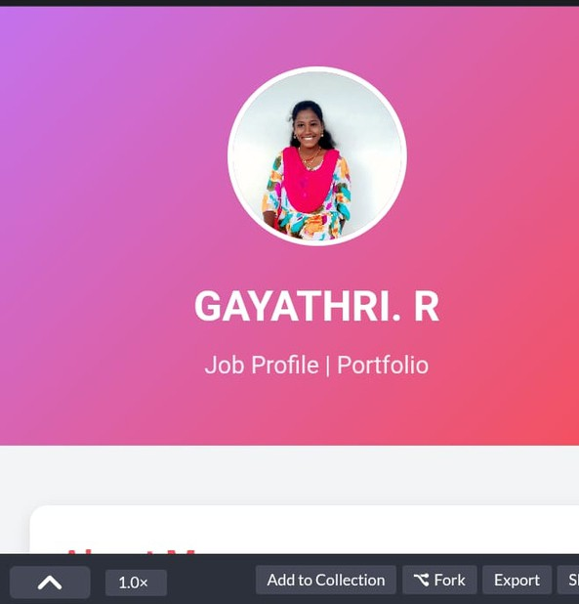
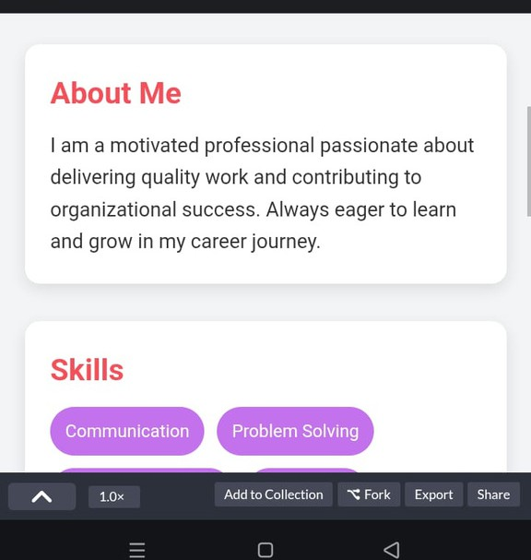
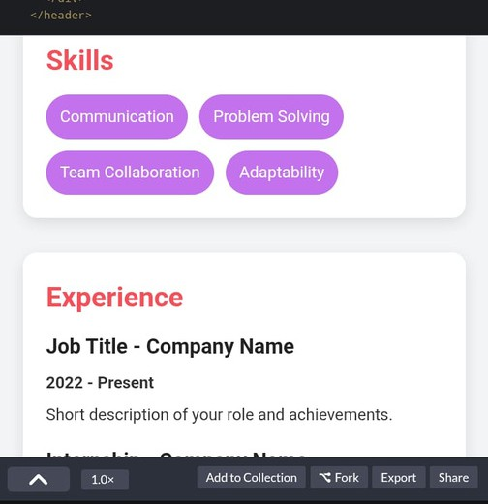
Results and Screenshots
my portfolio output:

Slide 20
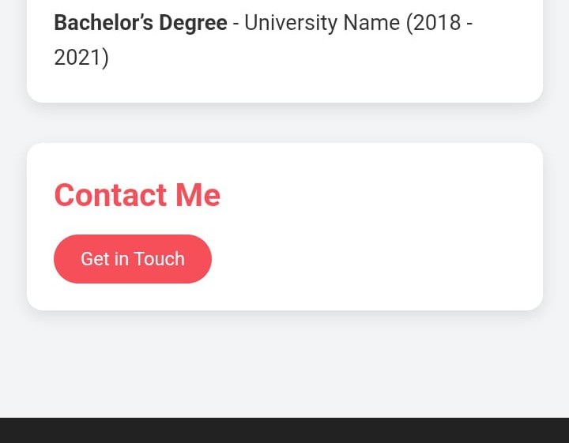
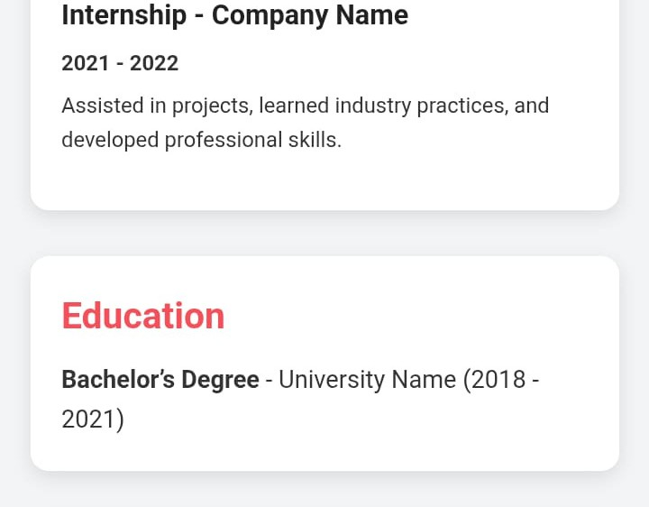
Results and Screenshots

Slide 21
CONCLUSION
The Student Digital Portfolio provides an innovative and effective way for students to present their academic achievements, skills, projects, awards, and personal interests in a professional and visually appealing format. Unlike traditional resumes or paper-based portfolios, this digital version is interactive, easily accessible, and customizable, making it more suitable for the modern digital era.
This portfolio not only helps students in showcasing their talents and accomplishments but also serves as a powerful tool for career opportunities, academic evaluation, and personal branding. With features like responsive design, project showcase, achievements section, and contact information, it bridges the gap between students and potential educators, mentors, or employers.

Slide 22
THANK YOU

